Slide 1
Order Based V Tracking Application for Android Handset
User Guide

Slide 2
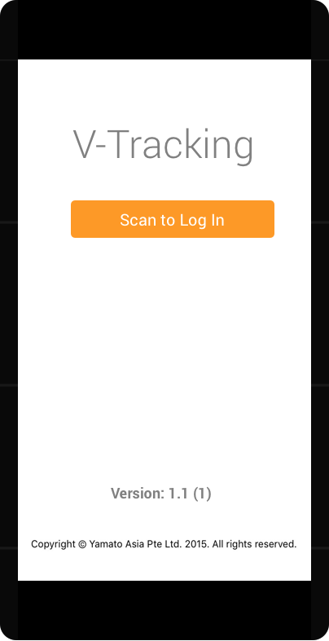
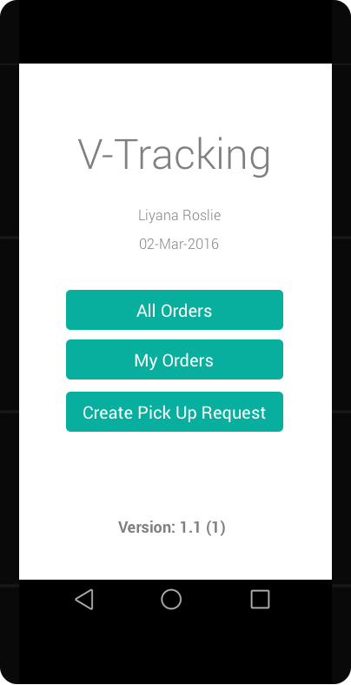
Log In
Press the button to scan Driver ID

Slide 3
Normal Delivery Scenario After Login (Prepaid/COD)
Scan the order code
Click on “All Orders” button
Click on the order if you can find in the page or press camera icon on top right corner
Click on Scan to complete Job button and scan the order code
Click on Yes button

Slide 4
Normal Delivery Scenarios After Login (Exchange)
Scan the order code
Click on ‘Scan Exchange Code’ button and scan the exchange code
Click on ‘Exchange Confirmed’ button
Click on Yes button
Click on “All Orders” button
Click on the order if you can find in the page or press camera icon on top right corner

